Slide 1

6th Grade Accelerated Math
Unit 6, Lesson 9 Multiplying Integers Using Models Volume 1, pg. 273

Slide 2


Benchmark
MA.6.NSO.4.2
Apply and extend previous understandings of operations with whole numbers to multiply and divide integers with procedural fluency.
volume 1, pg. 273

Slide 3
Integrated Mathematical Thinking and Reasoning Standards
MA.K12.MTR.2.1 Demonstrate understanding by representing problems in multiple ways.
MA.K12.MTR.3.1 Complete tasks with mathematical fluency.
MA.K12.MTR.5.1 Use patterns and structure to help understand and connect mathematical concepts.
volume 1, pg. 273

Slide 4

Learning Target
I can multiply integers using integer chips, number lines, and patterns.
volume 1, pg. 273

Slide 5

Warm-Up
volume 1, pg. 274

Slide 6
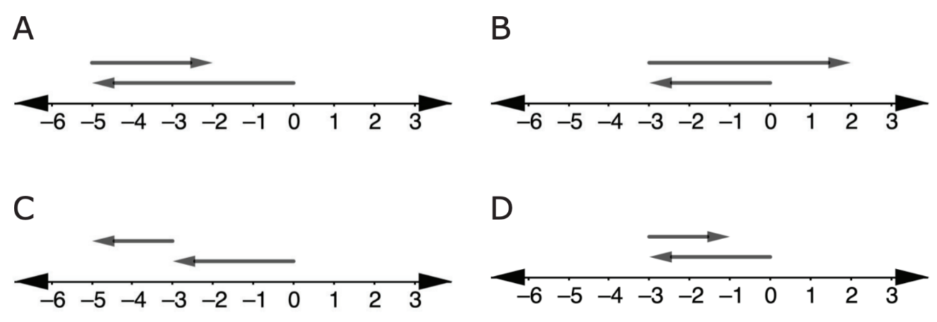
6.9.1 Warm-Up: Which One Doesn’t Belong?
1. Four number lines modeling addition are shown.
Explain which one doesn’t belong.
volume 1, pg. 274

Slide 7

Exploration
volume 1, pg. 274

Slide 8

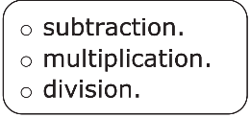


6.9.2 Exploration: Using Integer Chips to Represent Multiplication
1. The addition expression 7 + 7 + 7 can be written as
______ ∙ 7. This is because repeated addition of integers can be expressed as
2. The expression 5 × 2 can be interpreted as adding _____ groups of _____ or adding _____ groups of _____.
3. Use integer chips to represent one of these interpretations.
Recall that
= −1 and
= +1.
Draw a picture of your representation.
volume 1, pg. 274

Slide 9
4. Describe how the integer chips represent the value of the expression 5 × 2.
5. The expression 5 × (−2) can be interpreted as adding _____ groups of _____ or adding _____ groups of _____.
6. Explain which interpretation of 5 × (−2) you think would be easier to represent using integer chips.
7. Discuss your choice with your partner. Then, work together to use integer chips to represent one of the interpretations. Draw a picture of the representation.
volume 1, pg. 275

Slide 10
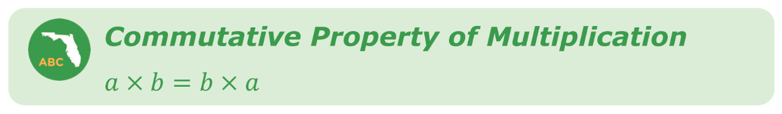
8. Describe how the integer chips represent the value of the expression 5 × (−2).
9. What is the value of the expression 5 × (−2)?
The commutative property of multiplication states that the order in which multiplication is performed does not change the value of the expression.
10. Using the commutative property of multiplication, what is the value of the expression 2− × 5?
volume 1, pg. 275

Slide 11
Exploration
volume 1, pg. 275

Slide 12
6.9.3 Exploration: Multiplying a Negative Integer by a Negative Integer
1. Complete the statement.
The expression, (−5)(−2), indicates that ______ groups
of ________ should be removed.
2. Use the steps below to discover how to represent (−5)(−2) using integer chips.
Step 1: First, use your integer chips to create the set of zero pairs that will be needed to find (−5 )(−2). Draw the groups of zero pairs in the box below.
Step 2: Remove 5 groups of 2 negative integer chips.
Step 3: Remove any remaining zero pairs, if needed.
volume 1, pg. 275

Slide 13
3. Complete the statement.
The value of expression (−5 )(−2) is _______.
4. With your partner, discuss whether or not you think the product when multiplying two negative values will always be positive. Explain your thinking.
volume 1, pg. 275

Slide 14

Guided Instruction
volume 1, pg. 276

Slide 15
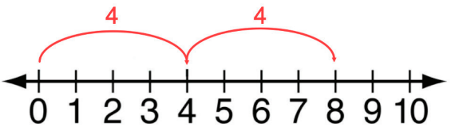
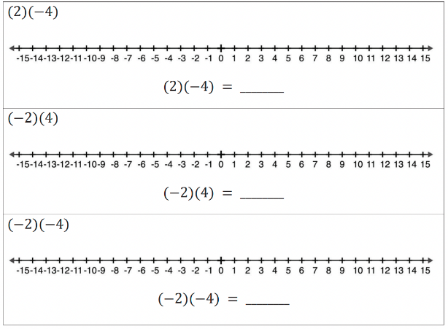
6.9.4 Guided Instruction: Multiplying Integers Using the Number Line
Recall that (2)(4) means 2 groups with 4 units in each group. The product is the total number of objects.
This can be represented on the number line as shown.
1. Represent each multiplication expression on the number line. Then, use it to complete the equation.
volume 1, pg. 276

Slide 16

Guided Practice
volume 1, pg. 276

Slide 17

6.9.5 Guided Practice: Multiplying Integers Using Models
1. Use integer chips to model and evaluate each expression.
a. (3)(−5) =
b. −2 × −2 =
volume 1, pg. 276

Slide 18
2. Use a number line model to evaluate each expression.
a. (8)(−1) =
b. (−4)(−4) =
3. Which model for multiplication of integers do you prefer: multiplication chips or the number line?
volume 1, pg. 276

Slide 19

Your Turn
volume 1, pg. 277

Slide 20
6.9.6 Your Turn!
1. Find the value of each expression using your preferred method.
a. 2 × −8
b. −6 ∙ (−3)
c. (−7)(−6)
d. 5(−3)
e. −9 × −4
f. 7 ∙ 5
volume 1, pg. 277

Slide 21

Wrap-Up
volume 1, pg. 277

Slide 22
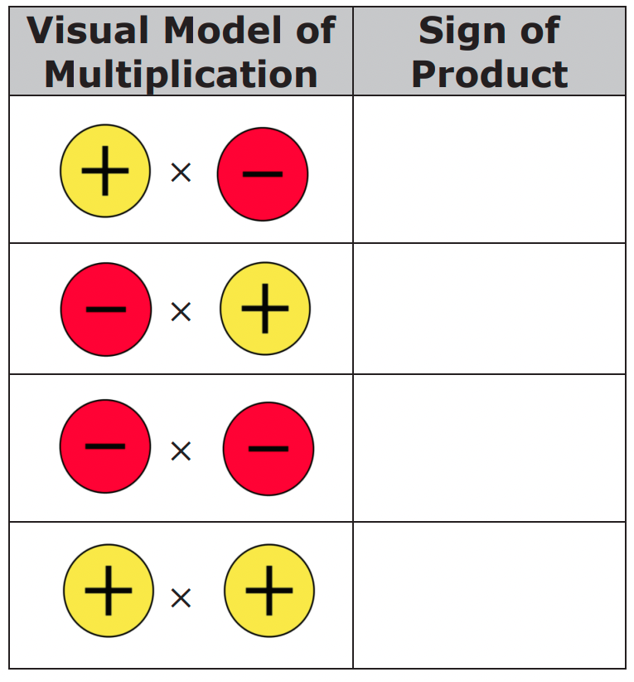
6.9.7 Wrap-Up: Cool Down
1. Complete each rule by drawing the sign of the product as an integer chip.
volume 1, pg. 277

